Slide 1
Data Science Class 3: Python conditions
Puranjit Singh
09/08/2021

Slide 2

What are if and else statements in Python?
If statement is used as a condition statement to test an expression
Elif statement are used as a condition statement to test an expression other than that in if statement
Else statement is used as the ultimate result for the test expression when all other statements are false
https://www.pngitem.com/middle/Thmwm_transparent-designer-clipart-programmer-cartoon-hd-png-download/
Notes:
So, in general when we are executing if-else statements, its not necessary to include elif statements are not required most of the times
At first, if statements are executed and the expression under if statement are executed when condition provided under them is true
If not Elif condition is checked, and it runs if the condition satisfies/true to execute the command present under it
Otherwise, else statements are executed when all other conditions are not true

Slide 3
Flow diagram and syntax
Test expression
Basic syntax:
If test-expression:
# Body of if
elif:
# Body of else if
else:
# Body of else
TRUE
FALSE
Body of If
Test expression
FALSE
TRUE
Body of elif
Body of else

Slide 4
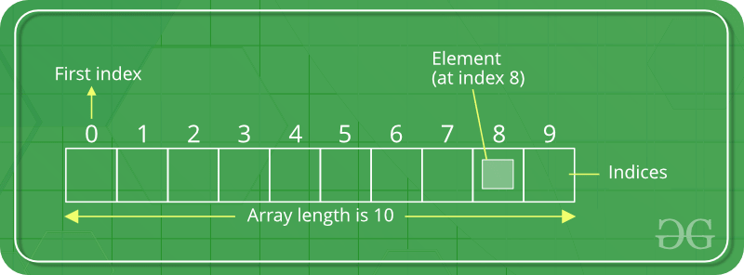
What is an Array?
An array is basically a data structure which can hold more than oner value at a time. It is a collection of ordered series of elements of the same type
https://www.geeksforgeeks.org/python-arrays/
Difference between an array and a list
Notes:
We can store multiple values of similar datatype in an array, each element stored in an array has a separate memory allocation
Elements in an array are stored at different indexes and could be accessed using that index, Indexing in an array always starts from 0
The main difference between an array and a list is that a list can store values of different types of data whereas an array can store values only of a similar datatype (like we can store strings with int and float but not in array). Create array by importing array
Array can be handled in Python by a module named array. They can be useful when we have to manipulate only a specific data type values. A user can treat lists as arrays. However, user cannot constraint the type of elements stored in a list. If you create arrays using the array module, all elements of the array must be of the same type.

Slide 5
Basic array operations
Finding the length of an array
Array concatenation
Adding/changing element of an array
Operations
Slicing
Removing/deleting elements of an array
Looping through an array

